Slide 1
Tips for Deep Learning
Instructor: Dr. Yan Yan

Slide 2

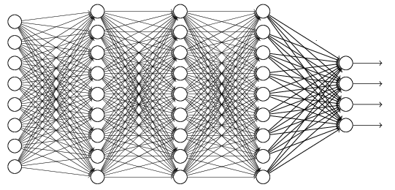
Recipe of Deep Learning
YES
Step 1: define a set of function
Step 2: goodness of function
Step 3: pick the best function
NO
Good Results on Testing Data?
Overfitting!
YES
NO
Good Results on Training Data?
Neural Network

Slide 3
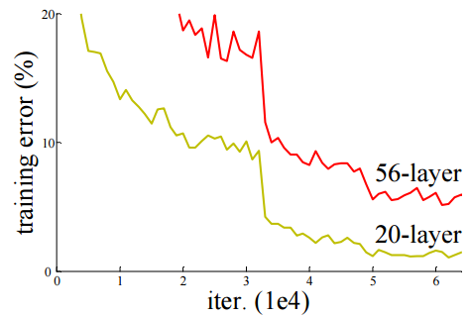
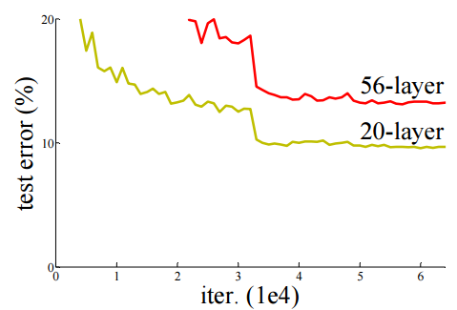

Do not always blame Overfitting
Not well trained
Overfitting?
Training Data
Testing Data
Deep Residual Learning for Image Recognition
http://arxiv.org/abs/1512.03385

Slide 4
Recipe of Deep Learning
YES
Good Results on Testing Data?
Different approaches for different problems.
YES
e.g. dropout for good results on testing data
Good Results on Training Data?
Neural Network

Slide 5
Recipe of Deep Learning
YES
Early Stopping
Good Results on Testing Data?
Regularization
Dropout
YES
New Activation Function
Good Results on Training Data?
Adaptive
Learning Rate

Slide 6
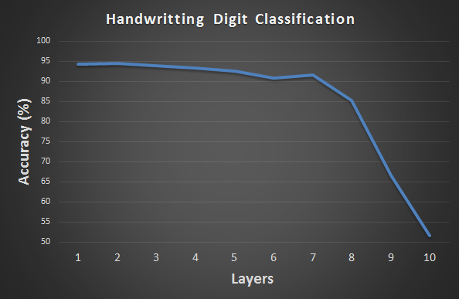
Hard to get the power of Deep …
Results on Training Data
Deeper usually does not imply better.

Slide 7
Vanishing Gradient Problem
……
y₁
……
y₂
……
……
……
……
……
……
y_{M}
Smaller gradients
Larger gradients
Learn very slow
Learn very fast
Almost random
Already converge

Slide 8
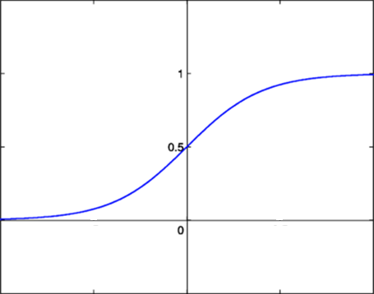
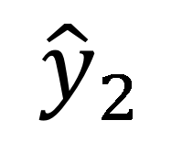

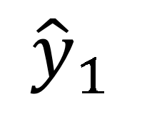
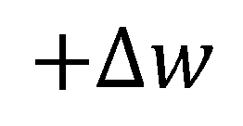
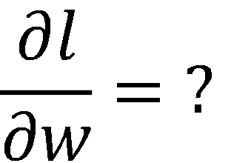
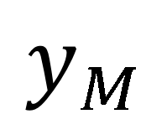

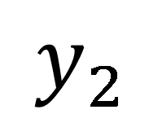
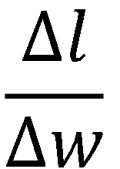
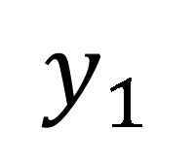
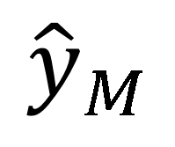
Vanishing Gradient Problem
Smaller gradients
……
$$y_{1}$$
$${\hat{y}}_{1}$$
Small output
……
$$y_{2}$$
$${\hat{y}}_{2}$$
……
……
……
……
……
$$l$$
……
$$+∆l$$
……
$$y_{M}$$
$${\hat{y}}_{M}$$
Large input
$$+∆w$$
Intuitive way to compute the derivatives …
$$\frac{∂l}{∂w}=?$$
$$\frac{∆l}{∆w}$$

